Slide 1
Shor’s Algorithm Implementation
Scott McHaffie, Jai Anand Iyer, Venkatesh Elayaraja
Department of Applied Physics
Kungliga Tekniska Högskolan (KTH)

Slide 2
Chapters
Project Scope
Background
Methodology
Implementation
Experiments and Results
Discussion
References

Slide 3
Project Scope
Problem Addressed:
Shor’s Algorithm
Project Direction:
Limitations of Full-Adder based Modulo Function
Classical implementation of Modular Exponentiation
Study Setup:
Unit tests: N = [15, …, 100], base = [2, 3]
Software:
Language: Python
Packages: Qiskit, NumPy, Matplotlib

Slide 4
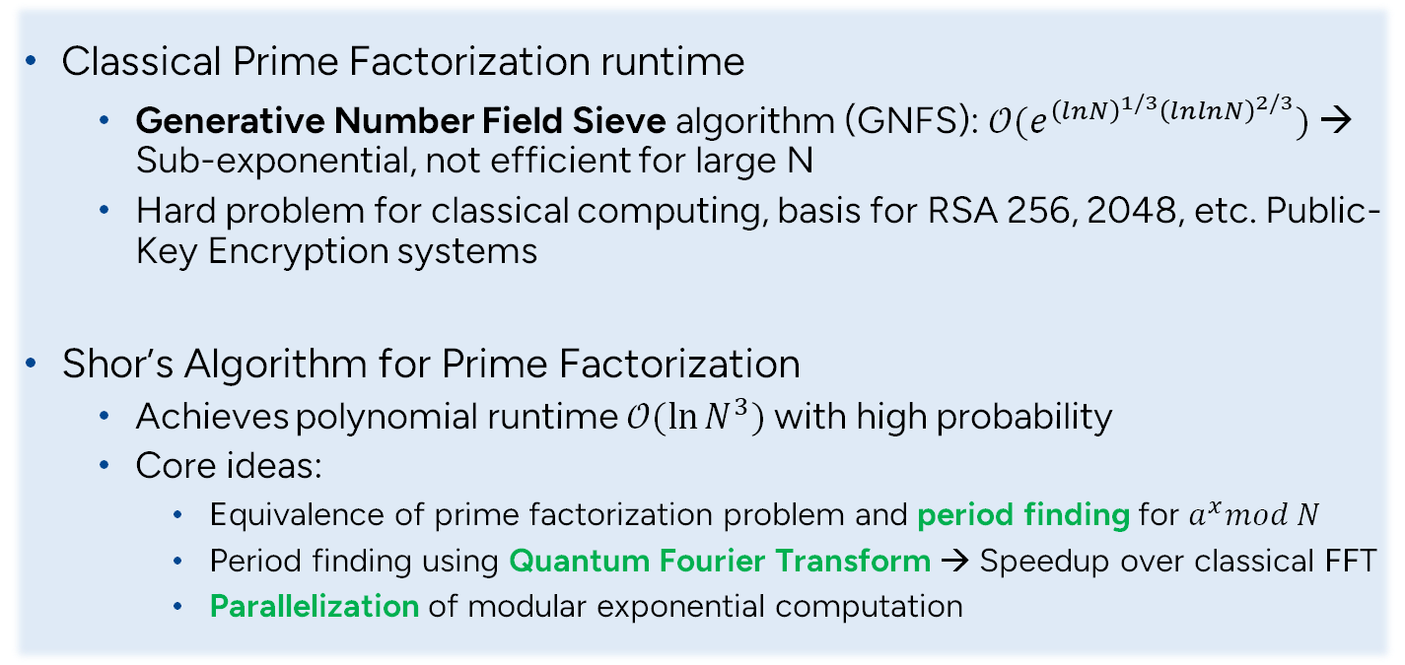
Background
Classical Prime Factorization runtime
Generative Number Field Sieve algorithm (GNFS): $𝒪(e^{{\left(lnN\right)}^{1/3}{\left(lnlnN\right)}^{2/3}})$ → Sub-exponential, not efficient for large N
Hard problem for classical computing, basis for RSA 256, 2048, etc. Public-Key Encryption systems
Shor’s Algorithm for Prime Factorization
Achieves polynomial runtime ${𝒪(ln{N}}^{3})$ with high probability
Core ideas:
Equivalence of prime factorization problem and period finding for $a^{x}mod N$
Period finding using Quantum Fourier Transform → Speedup over classical FFT
Parallelization of modular exponential computation

Slide 5
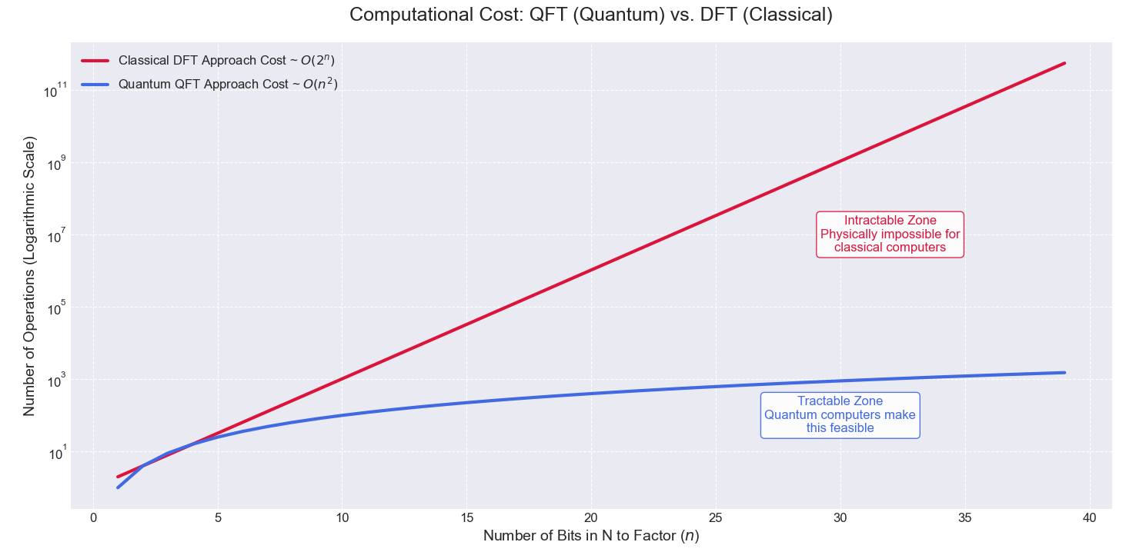
Background DFT vs QFT
Classical DFT: Exponential Time - $O\left(2^{n}\right)$. Hits an "impossibility wall".
Quantum QFT: Polynomial Time - $O\left(n^{2}\right)$. Stays tractable and efficient.

Slide 6
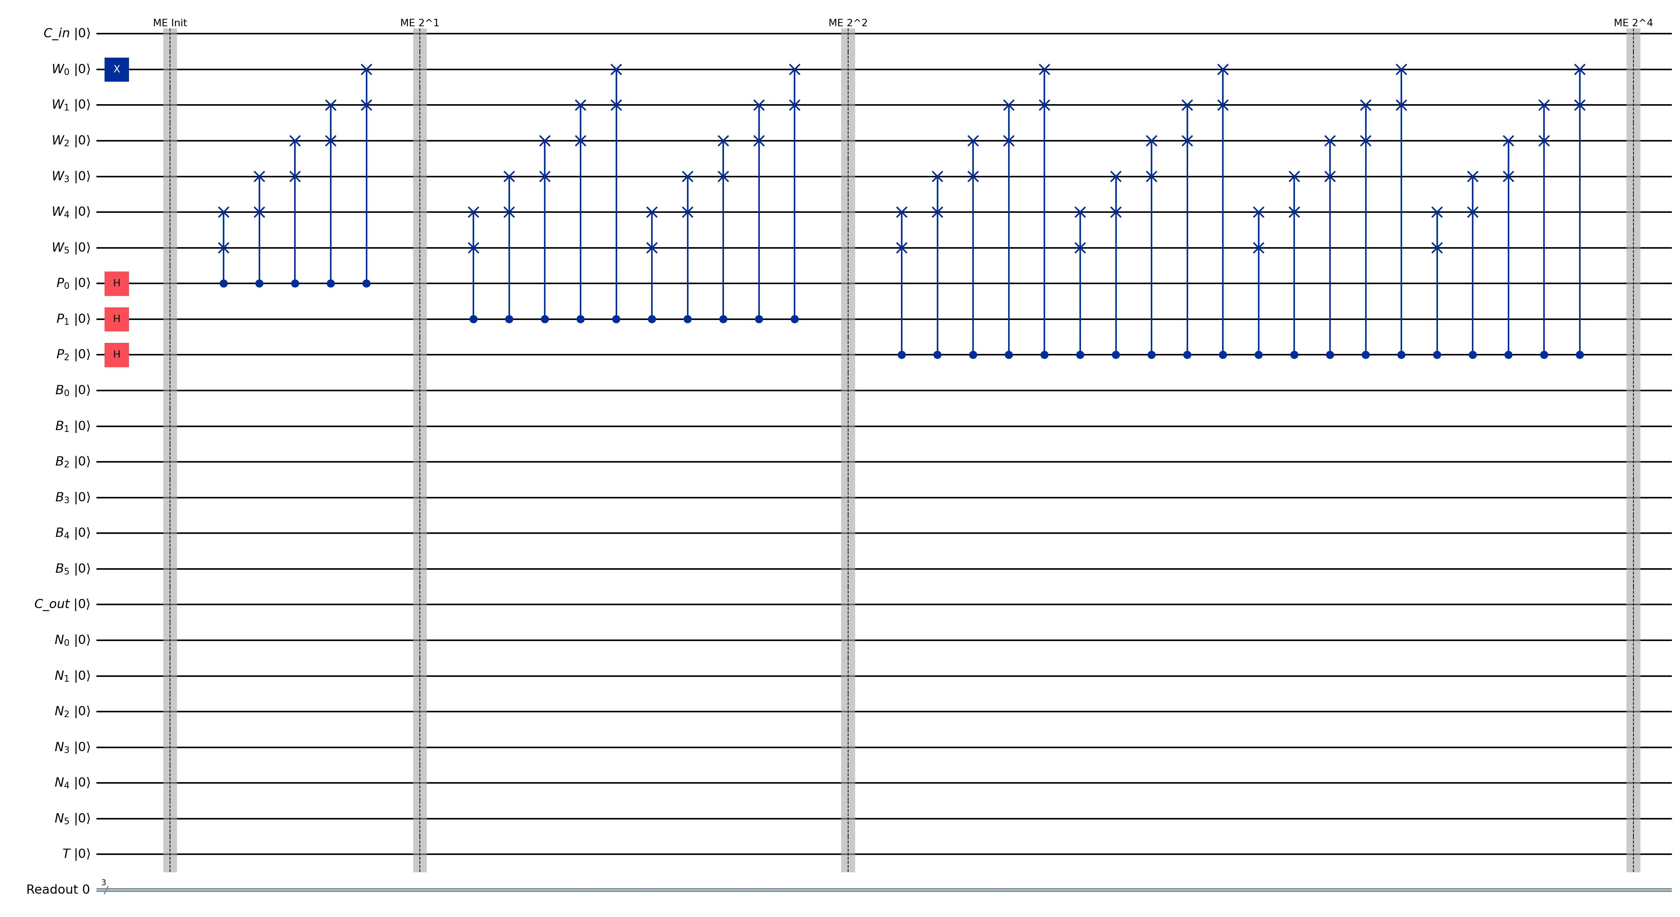
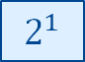
Methodology Quantum Exponentiation
$$2^{1}$$

Slide 7
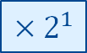
Methodology Quantum Exponentiation
$${×2}^{1}$$

Slide 8
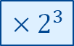

Methodology Quantum Exponentiation
$${×2}^{1}$$
$${×2}^{2}$$
$${×2}^{3}$$

Slide 9
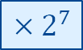
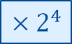
Methodology Quantum Exponentiation
$${×2}^{1}$$
$${×2}^{2}$$
$${×2}^{4}$$
$${×2}^{3}$$
$${×2}^{7}$$

Slide 10
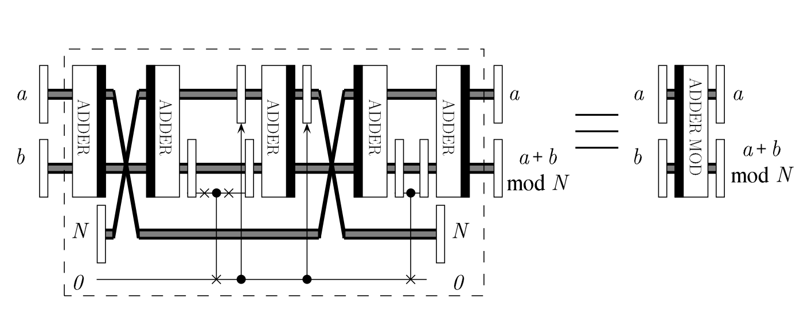
Methodology Quantum Adder Mod N
Figure is taken from [2]

Slide 11
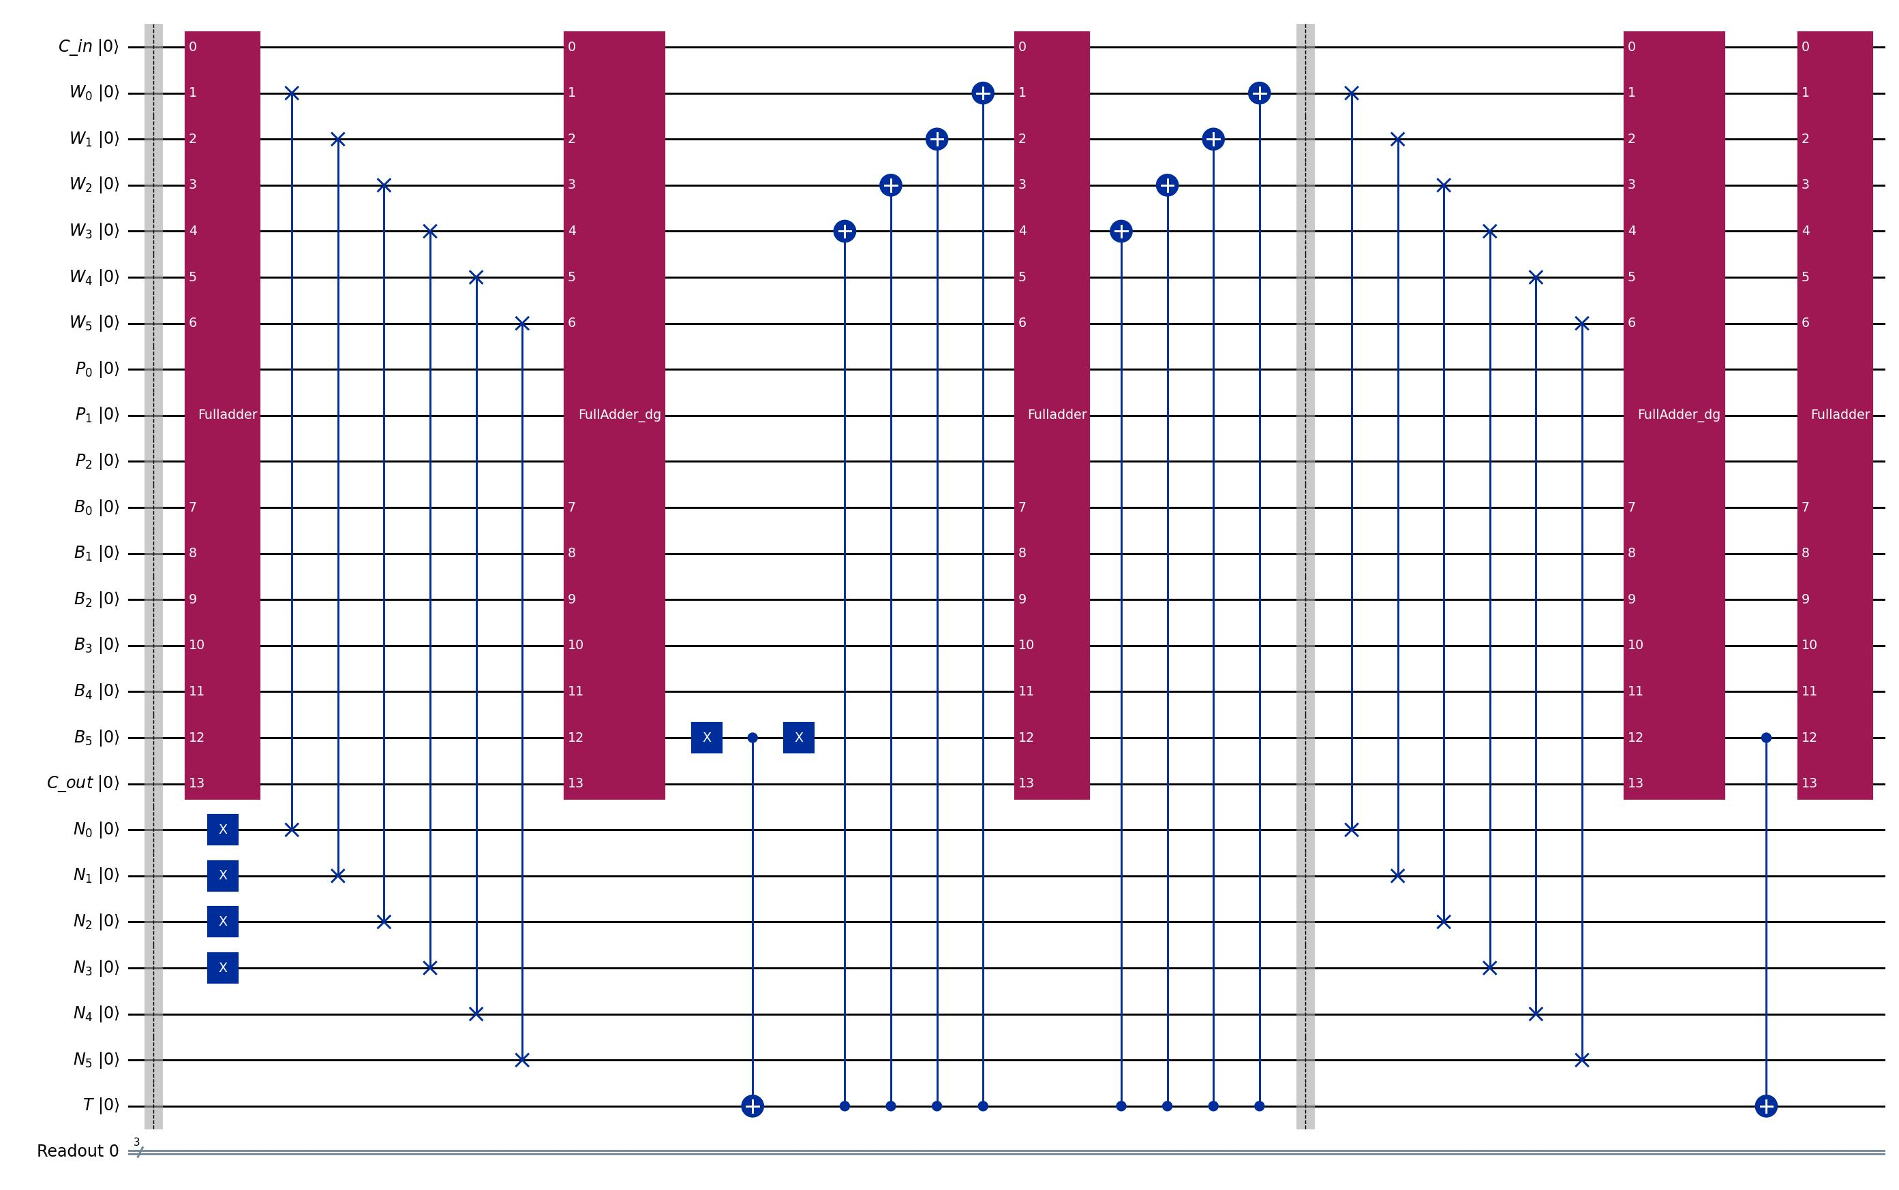
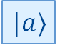
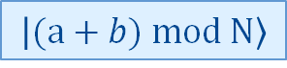

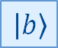
Methodology Quantum Adder Mod N
$$|a⟩$$
$$|a⟩$$
$$|b〉$$
$$|(a+b) mod N〉$$

Slide 12
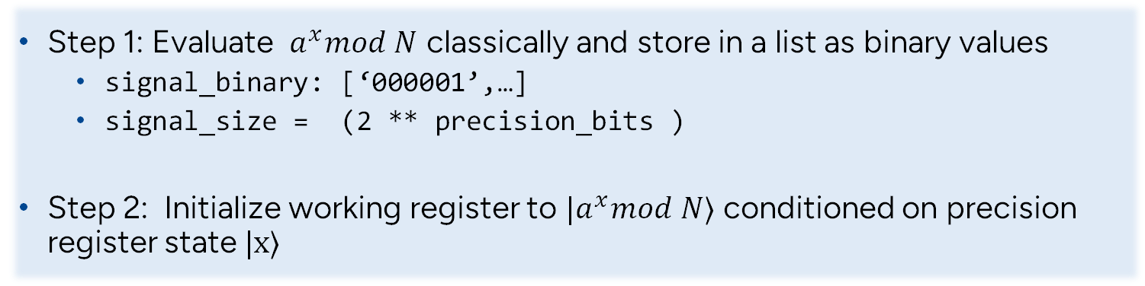
Methodology Classical Modular Exponentiation
Step 1: Evaluate $a^{x}mod N$ classically and store in a list as binary values
signal_binary: [‘000001’,…]
signal_size = (2 ** precision_bits )
Step 2: Initialize working register to $|a^{x}mod N⟩$ conditioned on precision register state $|x⟩$

Slide 13
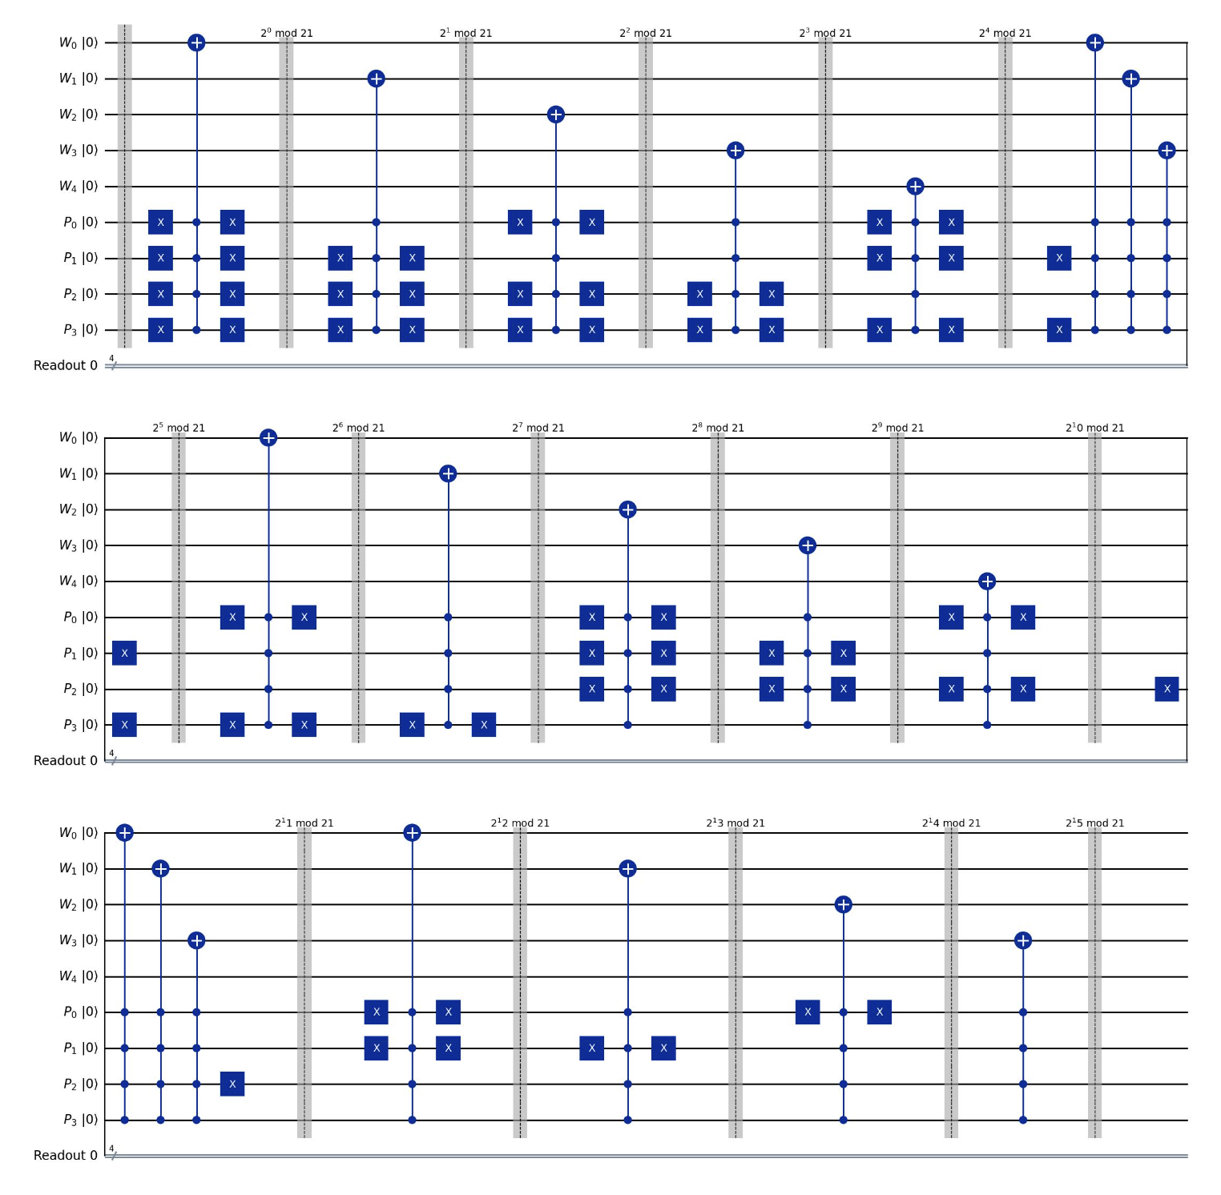
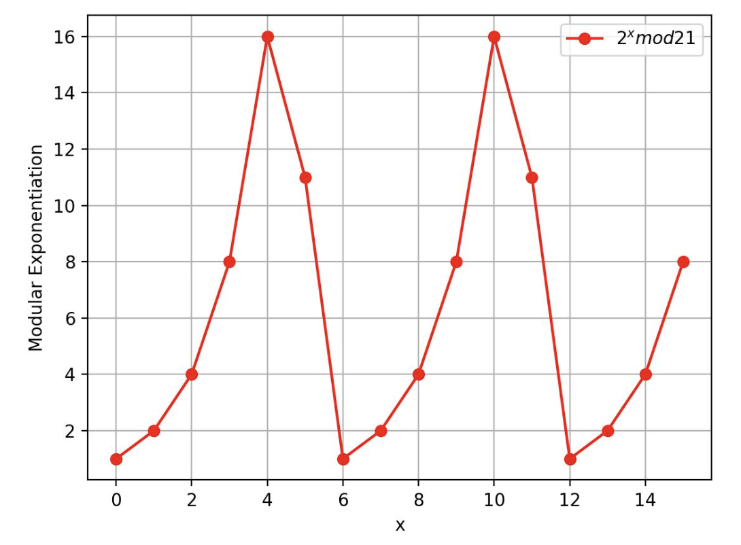
Methodology Classical Modular Exponentiation
Conditional Initialization
Signal for 2^x mod 21

Slide 14
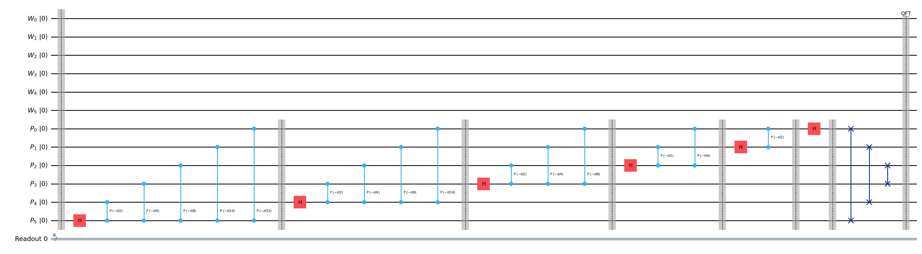

Methodology Quantum Fourier Transformation
$$\text{QFT}\left|j\right\rangle =\frac{1}{\sqrt{N}}\sum_{k=0}^{N−1}{e^{2πijk/N}\left|k\right\rangle }$$

Slide 15
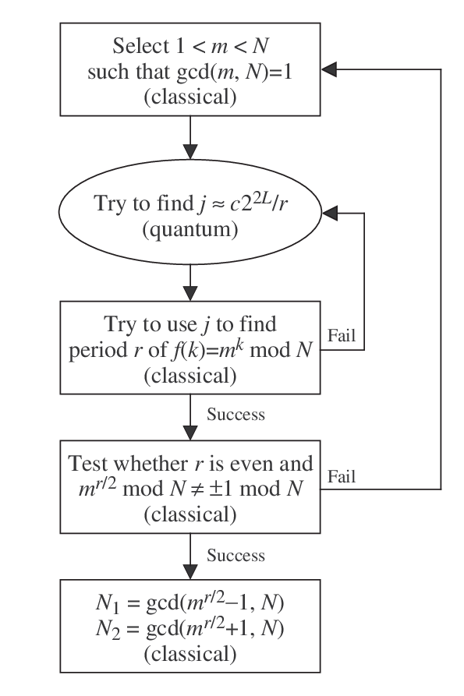
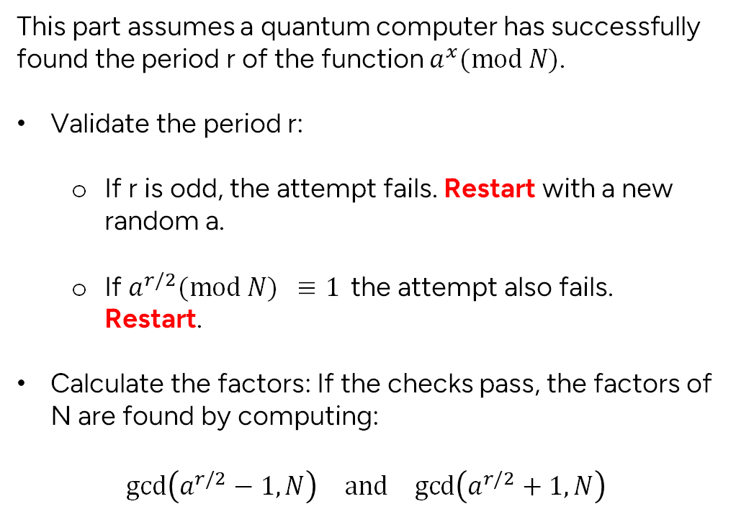
Methodology Classical Components
This part assumes a quantum computer has successfully found the period r of the function $a^{x}(mod N)$.
Validate the period r:
If r is odd, the attempt fails. Restart with a new random a.
If $a^{r/2}(mod N) ≡1$the attempt also fails. Restart.
Calculate the factors: If the checks pass, the factors of N are found by computing:
$$\text{gcd}\left(a^{r/2}−1,N\right) \text{and} \text{gcd}\left(a^{r/2}+1,N\right)$$

Slide 16
Implementation
Implemented on the Aer simulator
Ran into syntax trouble trying to call backends
Running 2048 shots
Using up to 7 working bits (allows up to 128) and 6 precision bits (to allow for 2^63 mod (N) in the precision register) to ensure spike finding algorithm works
From results, run the classical spike finding and factoring algorithms on ALL measured states, returning once any prime factors are found

Slide 17
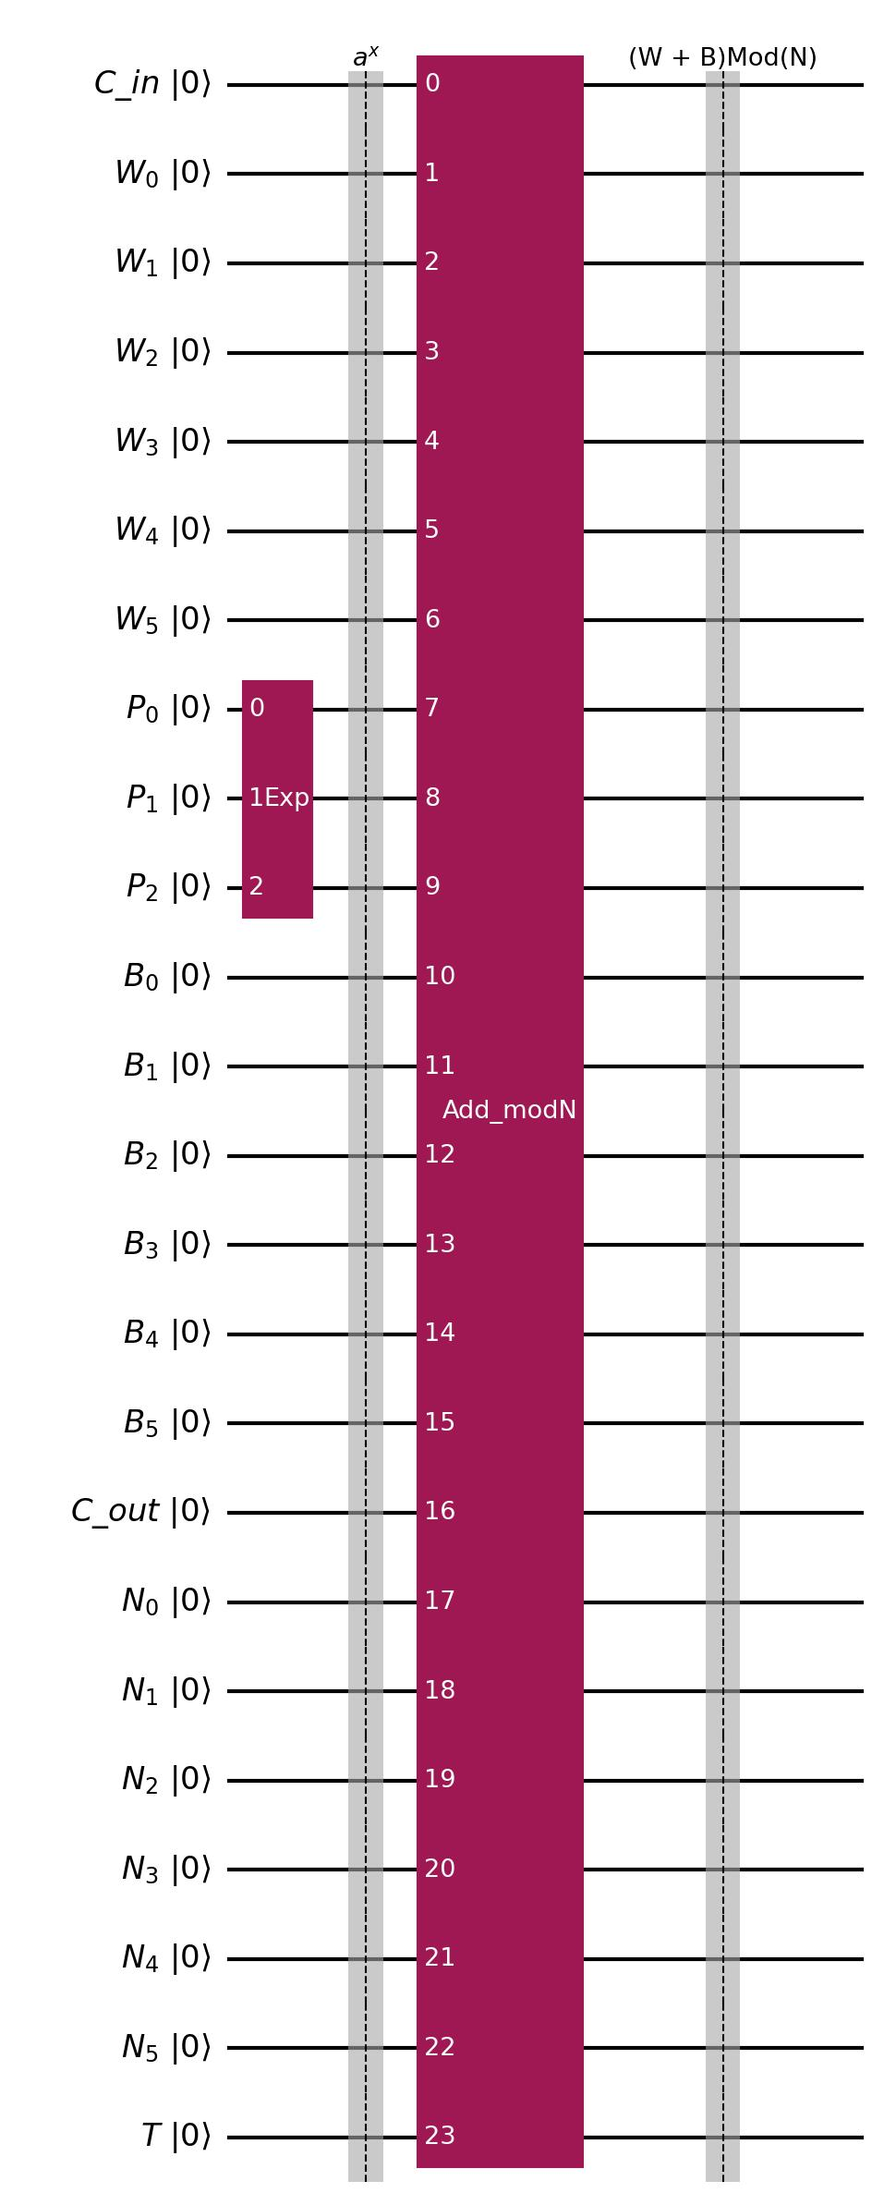
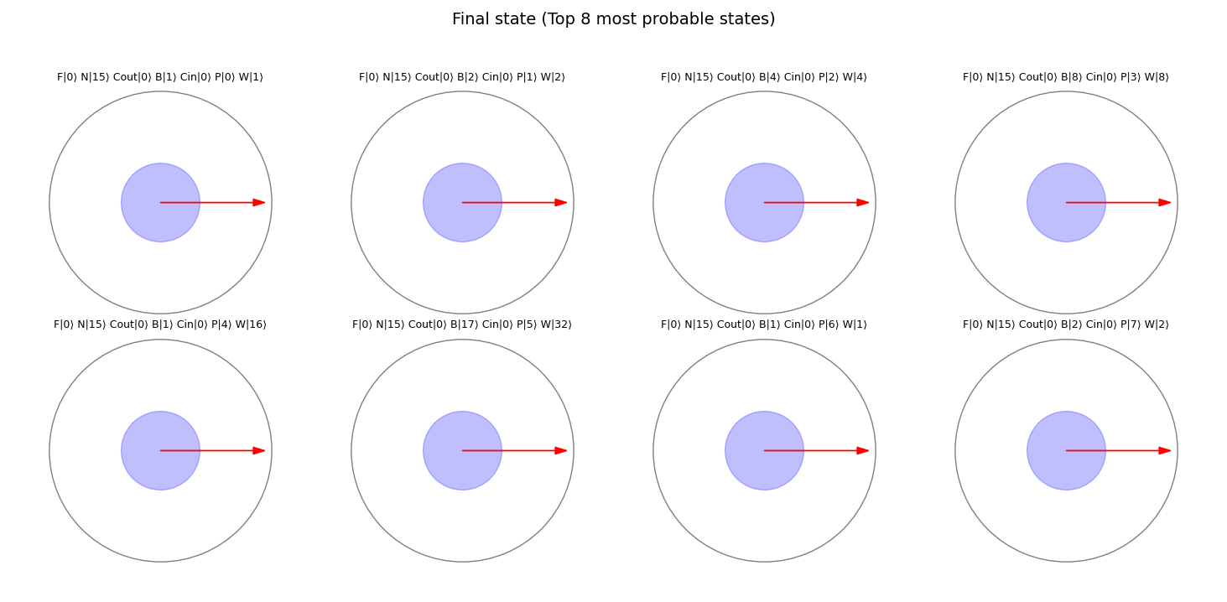

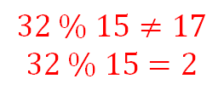
Experiments & Results – Mod 15 Quantum Modulo Exponentiation: $a=2, N=15$
$$32 \% 15≠17$$
$$32 \% 15=2$$

Slide 18


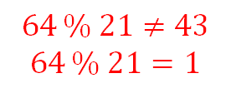

Experiments & Results – Mod 21 Quantum Modulo Exponentiation: $a=2, N=21$
$$64 \% 21≠43$$
$$64 \% 21=1$$
18

Slide 19
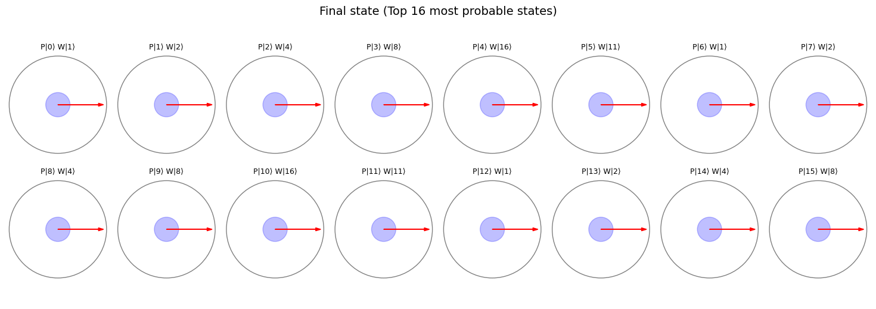
Experiments & Results Classical Modulo Exponentiation - Conditional Initialization
a = 2, N = 21

Slide 20
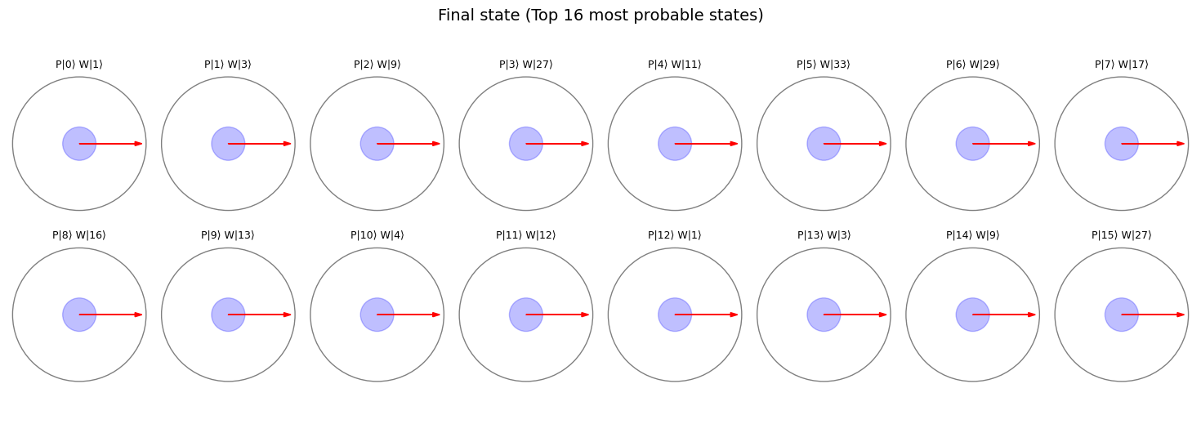
Experiments & Results Classical Modulo Exponentiation - Conditional Initialization
a =3, N = 35

Slide 21
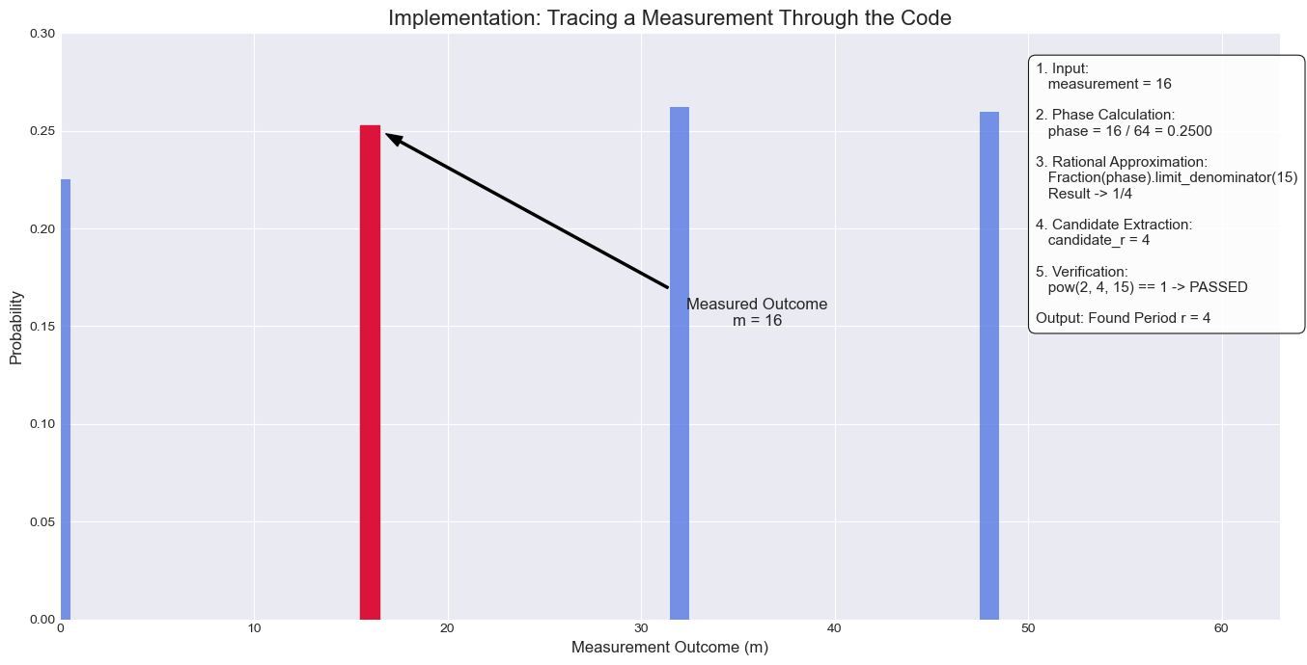
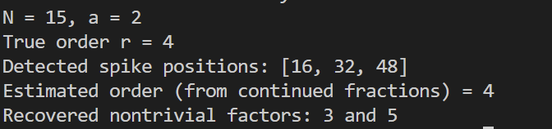
Experiments & Results Classical Peak finding from QFT Probabilities

Slide 22
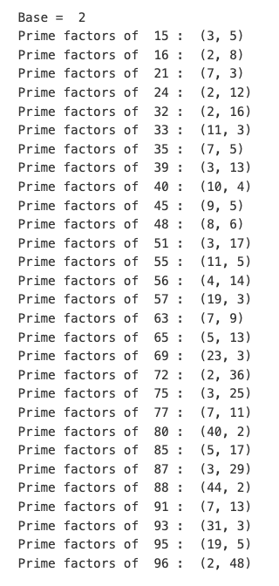
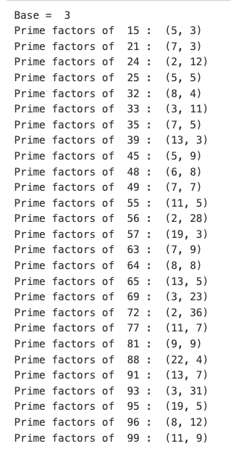
Experiments & Results Classical Modulo Exponentiation – Results from Prime Factorization

Slide 23
Discussion – Prime Factorization
We implemented Shor’s Algorithm to search for factors of all integers from 15 to 100, using the base value = {2, 3}
Using base 2, we found prime factors of all integers of the form N = p * q where {p, q} are prime numbers
Using base 3, we factorized less numbers → need to use bigger precision register, increases computation time
Using base 5 and above is difficult due to very large numbers from exponentiation → can try repeated modulo

Slide 24
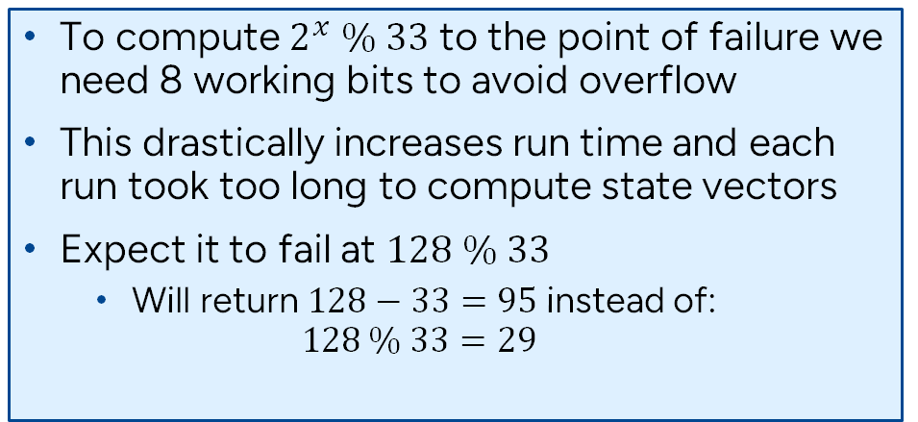
Discussion – Mod 33 and Above Quantum Modulo Exponentiation
To compute $2^{x} \% 33$ to the point of failure we need 8 working bits to avoid overflow
This drastically increases run time and each run took too long to compute state vectors
Expect it to fail at $128 \% 33$
Will return $128−33=95$ instead of:
$$128 \% 33=29$$

Slide 25
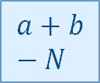
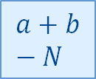
Discussion – The Failure of the Modulo Adder Quantum Modulo Exponentiation
Ultimately the “modulo adder” implements $a+b−N$
$$a+b−N$$
$$a+b−N$$
Figure is adapted from [2]
Therefore, the adder is only valid for $a+b<2N$

Slide 26
Work Division & Expected Grade
We expect a final grade of A. We implemented Shor’s Algorithm and:
Compared quantum to classical modular exponentiation
Completed unit tests from N = [15, …, 100] with base = [2, 3]
This report meets the A grade
Individual Contributions
Scott McHaffie:
Developed code for Quantum Addition Modulo N, running the quantum circuit, the digital logic to process the results and return prime factors
Jai Anand Iyer:
Developed code for Classical Modular Exponential Initialization, Quantum Exponentiation, Quantum Addition Modulo N
Venkatesh Elayaraja:
Developed code for the Quantum Fourier Transform (QFT) and its inverse
Developed unit tests for the Shor’s circuits, and classical code, Optimized visualizations for probability distribution of state vectors

Slide 27
References
Markidis, S., 2025. Lecture slides: DD2367 Quantum Computing for Computer Scientists. KTH Royal Institute of Technology.
Vedral, V., Barenco, A. and Ekert, A., 1996. Quantum networks for elementary arithmetic operations. Physical Review A, 54(1), pp.147–153. doi:10.1103/PhysRevA.54.147.
Fowler, Austin., 2005. Towards Large-Scale Quantum Computation. https://arxiv.org/abs/quant-ph/0506126

Slide 28
Background
O(exp(N)) runtime of classical prime factorization
Equivalence of prime factorization of N to period finding of a^x % N
Quantum speed-up due to QFT and parallelization of modular exponentiation
Show graph of speed up times, etc.

Slide 29
Methodology
Circuit Design:
Quantum Modular :
exponentiation
add_mod_N()
Classical Modular:
mod_exp_init()
QFT
Mention tradeoffs between the two
Classical spike finding

Slide 30
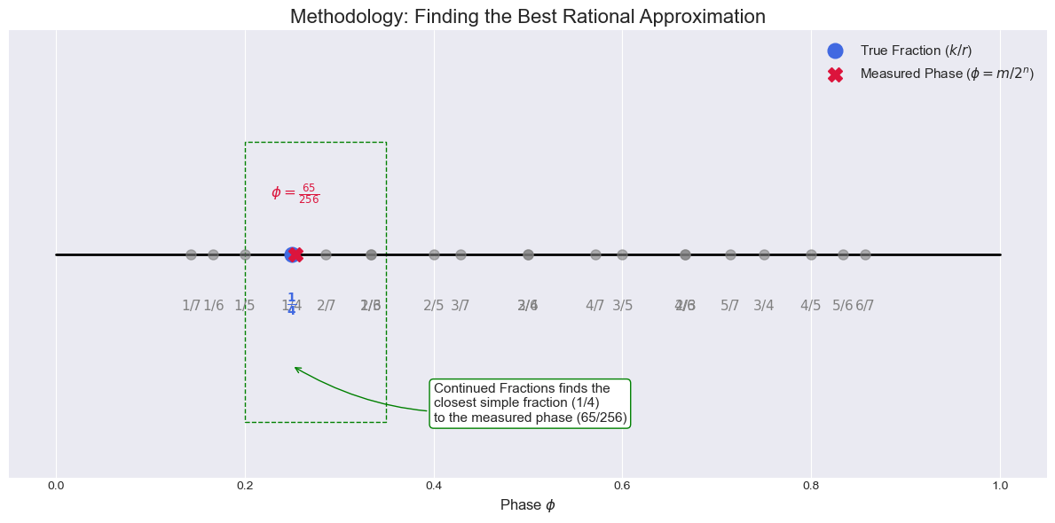
Methodology Classical Phase Approximation (Peak finding)
This plot visualizes the core task of the classical post-processing in Shor's algorithm. It shows how the Continued Fractions Algorithm finds the best simple fraction

Slide 31
Experiments & Results
Validation procedure
Quantum modulo exponentiation
Show where this fails, circle plots
Classical modulo exponentiation
Circle plots to show correctly initialized registers - DONE
QFT
Compare to Qiskit (this is probably best) or classical DFT (we did this in the last assignment) DONE
Measurement and prime factors
Show with a simple case probabilities of different states, outputs from the spike finding function, as well as found prime factors DONE
Prime number factorization for bases 2, 3 (explain why 5 does not work) DONE
Record the base number as well as the returned prime factors DONE
Do this for all numbers between 15 to 35 DONE
Show Venky’s unit test results

Slide 32
Discussion
Quantum modulo exponentiation didn’t work
Gave us quite a headache trying to figure this out, adding flag bits, etc.
Going above base 3 in the classical exponentiation (numbers are too big)

